Slide 1
Searching Arrays
Locating Data Within arrays

Slide 2
Locating Something in an Array
The problem: You want to find a specific value within your array
You might want a copy of it back (the located value itself)
You might want to just know WHERE it is (its position)
How?
Use a search algorithm

Slide 3
What is a Search Algorithm?
Search algorithm: a methodical approach to processing data in an array to locate a specific match to a supplied value
There are a few approaches/algorithm options available:
Linear search
Binary search
Jump/block search
Hash-based storage (bit of a stretch…)
Choosing an algorithm usually comes down to your data
Is it in sorted order?
Is it in unsorted/random order?
We’ll cover these
We’ll see this in Data Structures

Slide 4
Finding Data in an Unsorted Array
The problem: You want to find a value within your array BUT you are working with an unsorted array
Unsorted arrays mean the data is scattered in an unpredictable manner
Have to assume that a match could exist ANYWHERE in the array
The solution – linear search:
Loop through all elements in the array
If we find a match, return the position/value
If we get to the end of the array without finding a match, return that no match was found*

Slide 5
What is Linear Search?
Linear search: proceeding through the array in a straight line
Visit each slot in order and compare it to what we’re looking for
Same thing you’ve been doing since first year
Linear search is the most basic approach to searching
For each element in structure
Check if it matches what we need
If yes, return it/position of it
If we reach the end of the structure without finding a match, no match is present

Slide 6
Linear Search – The Algorithm
For each element in the array, compare it to what we’re seeking
If it matches, return the position/value
If we get to the end of the loop and haven’t returned anything, no match is present in the array
Return that no match was found
How can we represent no match being found:
When we’re finding the position of the element?
When we’re finding the element itself?

Slide 7
Illustrating Linear Search
0 | 1 | 2 | 3 | 4 | 5 | 6 | 7
8 | 12 | 22 | 31 | 43 | 44 | 50 | 87
Search this array for the number 50
Linear search: Check slot 0, then slot 1, then slot 2, then slot 3, then slot 4, then slot 5, then slot 6
[match found in 7 iterations]

Slide 8
The Drawbacks of Linear Search
Essentially unoptimized – Big O value of O(n)
Must visit every slot to know we haven’t found a match
Can’t skip any slots to get to the result faster
Only possible optimisation (to improve the average case) is to:
Return from within the loop as soon as a match is found
Break out of the loop as soon as a match is found
Reason for lack of optimization: Assumes data isn’t sorted
Linear search is the only way to search unsorted data
If data isn’t sorted, the only way we can search is to check every slot
Two approaches that give the same end result.
Neither will change the Big O value

Slide 9
Searching Sorted Data With Linear Search
If data was sorted, how could we optimise linear search?
Only search until we find something that comes AFTER our data
For example: Searching an (ascending order) alphabetised array of names
For each element in the array
If the current element matches search term, return it/position of it
If current element should come AFTER search term in alphabetical order, return no match found
This is an optimization: If we can find something that comes after the search term, and we still haven’t found a match, it’s not there
Optimises the code to reduce the number of comparisons and iterations performed

Slide 10
Optimized Linear Search: Still Not a Perfect Solution
Linear search still may need to visit every slot
Worse case scenario: every value in array is smaller than search term
Need to visit every slot to confirm it doesn’t appear anywhere there
Because of this, linear search always has a worst case analysis (Big O value) of O(n), where n is the number of slots in the array/structure
We need a way to optimize this more - Enter binary search!

Slide 11
What is Binary Search?
Binary search is a search algorithm for sorted data
Divide and conquer approach: repeatedly divides the area within the array to be searched in half, and discards the section the match could not be found in
Instead of checking each element in turn, binary search checks the MIDDLE element of the array
If the middle element is a match, it returns the element/position of the element and finishes
If the middle element is too small, it discards everything up to the middle element and continues with the second half of the array
If the middle element is too big, it discards everything from the middle element to the end and continues with the first half of the array
In both the second and third situations, the search space has been cut in half

Slide 12
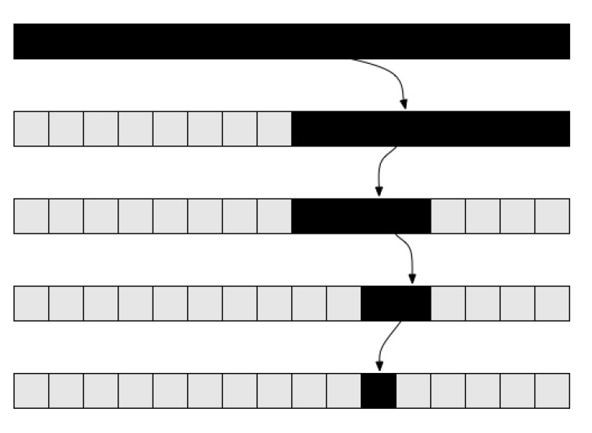
What Binary Search Looks Like
Every time you go around the structure, you half the amount of data you need to check next time
This data is still in the array, we’re just going to ignore it
1st pass: structure size = 16
2nd pass: structure size = 8
3rd pass: structure size = 4
4th pass: structure size = 2
5th pass: structure size = 1
We approximate this to log₂n, more commonly written as log n
Notes:
Good visualisation of this available at https://stackabuse.s3.amazonaws.com/media/binary-search-in-java-1.gif

Slide 13
Preparing for the Binary Search Algorithm – Establishing Boundaries
Binary search works on the idea of searching specific sections of an array
We don’t actually build smaller and smaller arrays
We reduce the size of the the section we’re looking at, and ignore everything outside that section
To do this, we need to track the boundary positions of the search section
First location within our search area – the start position
Last location within our search area – the end position
As we eliminate areas from our array, we update our start and end positions
If we know a value can’t be in the left side of the array, we move our start position up, so it’s not including that section
If we know a value can’t be in the right side of the array, we move our end position back/down, so it’s not including that section

Slide 14
Carrying Out Binary Search – Picking the Element to Check
Binary search doesn’t check EVERY element
That would make it linear search!
Binary search just looks at the middle value of the current section
Divides the information exactly in half
As data is sorted, all information on left is smaller, all data on left is bigger
Can use this to decide which side of the section to ignore
We use the start and end boundary positions to calculate the middle position:
middle = start + (end – start) / 2
If you did (start + end) / 2, it might be too big for what an int could hold and cause an error

Slide 15
Ending Binary Search – What is the Termination Condition?
With binary search, we’re not using a fixed progression
Not going to every element
Not moving the same direction every time
As we’re not doing a fixed progression, we can’t use a for loop, we need to use a while loop – while some situation hasn’t been hit, keep going
What is the situation in which the loop should end??
We want to keep going with our search while we still have information left to check (that hasn’t already been discarded)
while(start <= end)
If start < end, there are X elements/slots between start and end
If start == end, then they’re pointing to the same element/slot
If start > end, then the start position of the section is coming after the end position, which is impossible

Slide 16
The Binary Search Algorithm
Start = start position of structure
End = end position of structure (structure size – 1)
while start <= end
Middle =start + (end – start)/2 (this way, it can never overflow the int datasize)
If middle element in structure equals search term
Return element in middle position / return middle position
else if middle element in structure is less than search term
Set start to middle + 1 // Discard start of the array
else if middle element in structure is greater than search term
Set end to middle – 1 // Discard end of the array
If we get to this point, the entire array has been processed and no match has been found
Return null / -1 (depending on whether we’re finding the element or the position of the element)
Don’t forget the -1
If you leave this out, your algorithm will fail to find matches
This can be simplified to a default else as there’s no other possible situation

Slide 17
Analysing the Cost of Binary Search
Binary search is said to perform at log n cost
This is log₂ n – we use base 2 because we halve the structure’s size each time we iterate
Structure Size | Number of Iterations
10 | 4
100 | 7
100,000 | 17
1,000,000 | 20
1,000,000,000 | 30

Slide 18
Illustrating Binary Search
0 | 1 | 2 | 3 | 4 | 5 | 6 | 7
8 | 12 | 22 | 31 | 43 | 44 | 50 | 87
Search this array for the number 50
Set up stage:
set start = 0
Set end = array length – 1 (7)
First iteration:
Find the middle slot in the structure: 0+ (7-0) / 2 = 3
Check if value in slot 3 matches search term [No match]
Check if value in slot 3 is greater than search term [No match]
Check if value in slot 3 is less than search term [MATCH]
Discard start of structure up as far as middle + 1
// Set start to middle + 1 (4)
Start = 4
End = 7
Second iteration:
Find the middle slot in the structure: 4 + (7-4) / 2 = 5
Check if value in slot 5 matches search term [No match]
Check if value in slot 5 is greater than search term [No match]
Check if value in slot 5 is less than search term [MATCH]
Discard start of structure up as far as middle + 1
// Set start to middle + 1 (6)
Start = 6
End = 7
Third iteration:
Find the middle slot in the structure: 6+(7-6)/2 = 6
Check if value in slot 6 matches search term [MATCH]
Return position of matching element

Slide 19
Illustrating Binary Search: Another Example
0 | 1 | 2 | 3 | 4 | 5 | 6 | 7
8 | 12 | 22 | 31 | 43 | 44 | 50 | 87
Search this array for the number 22
Set up stage:
set start = 0
Set end = array length – 1 (7)
First iteration:
Find the middle slot in the structure: 0 + (7-0) / 2 = 3
Check if value in slot 3 matches search term [No match]
Check if value in slot 3 is greater than search term [MATCH]
Discard end of structure back as far as middle - 1
// Set end to middle - 1 (2)
Start = 0
End = 2
Second iteration:
Find the middle slot in the structure: 0 + (2-0) / 2 = 1
Check if value in slot 1 matches search term [No match]
Check if value in slot 1 is greater than search term [No match]
Check if value in slot 1 is less than search term [MATCH]
Discard start of structure up as far as middle + 1
// Set start to middle + 1 (2)
Start = 2
End = 2
Third iteration:
Find the middle slot in the structure: 2 + (2-2) / 2 = 2
Check if value in slot 2 matches search term [MATCH]
Return position of matching element

Slide 20
Comparing Search Algorithms
Linear search is highly inefficient
Checks every single element until it finds something
Linear search can only be optimised to a point:
Optimise by returning/breaking loop: No improvement if there’s no match
Optimise by stopping when we find something greater than the value we’re seeking
No improvement if all data in the array is less than the current value
Loses the major strength of linear search – requires the data to be sorted
Binary search is highly efficient
It discards half of the remaining elements to be checked every time it makes a comparison

Slide 21
Comparing Search Algorithms: Requirements & Worst Case Analysis
Data order requirement:
Linear search has no pre-requisites on the incoming data
Data in any order can be worked on with linear search
Binary search requires the structure be sorted prior to running
The binary search algorithm is based on the assumption that the data is in sorted order, otherwise we can’t discard sections of it safely
Worst case performance:
Linear search: O(n)
Worse case scenario analysis indicates it will visit EVERY slot
Binary search: O(log n)
Worst case scenario analysis indicates it will visit log n of the number of slots

Slide 22
Comparing Worst Case Scenarios: Linear Search
Worst case scenario for Linear Search: n iterations
Must go through all elements
Example: Structure containing 5 elements, searching for 56
Must iterate through all 5 elements – i.e. n iterations
Check slot 0 – no match
Check slot 1 – no match
Check slot 2 – no match
Check slot 3 – no match
Check slot 4 – no match
0 | 1 | 2 | 3 | 4
12 | 33 | 42 | 50 | 56

Slide 23
Comparing Worst Case Scenarios: Binary Search
Worse case scenario for Binary Search: log n iterations
Must go through log n elements
Reduce size of data structure by half on each iteration
Example: Structure containing 5 elements (slots 0-4), searching for 56 Log 5 = 2.32, which rounds up to 3
Check slot 2 – no match, look at tail of structure
Check slot 3 – no match, look at tail of structure
Check slot 4 – no match, no elements left
0 | 1 | 2 | 3 | 4
12 | 33 | 42 | 50 | 56

